Slide 1
Data Mining
Dr. Muhammad Muneeb Ullah
Slides adapted: Data Mining Fall’21 by Dr. Ejaz Ahmed
Notes:
1
1

Slide 2




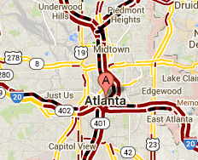
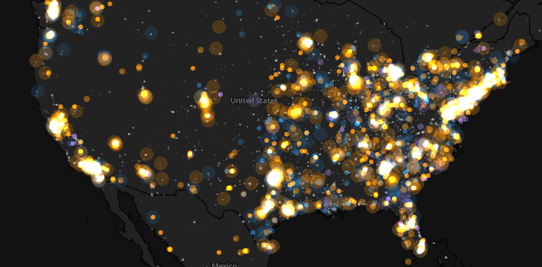
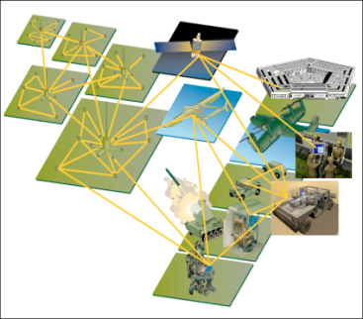
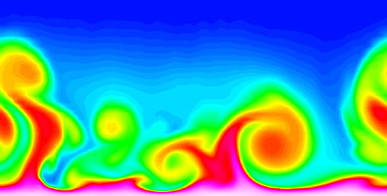
Data is Everywhere!
There has been enormous data growth in both commercial and scientific databases due to advances in data generation and collection technologies
New mantra
Gather whatever data you can whenever and wherever possible.
Expectations
Gathered data will have value either for the purpose collected or for a purpose not envisioned.
E-Commerce
Cyber Security
Traffic Patterns
Social Networking: Twitter
Sensor Networks
Computational Simulations
2
Notes:
2

Slide 3




Why Data Mining? Commercial Viewpoint
Lots of data is being collected and warehoused
Web data
Yahoo has Peta Bytes of web data
Facebook has billions of active users
purchases at department/ grocery stores, e-commerce
Amazon handles millions of visits/day
Bank/Credit Card transactions
Computers have become cheaper and more powerful
Competitive Pressure is Strong
Provide better, customized services for an edge (e.g. in Customer Relationship Management)
3
Notes:
3

Slide 4
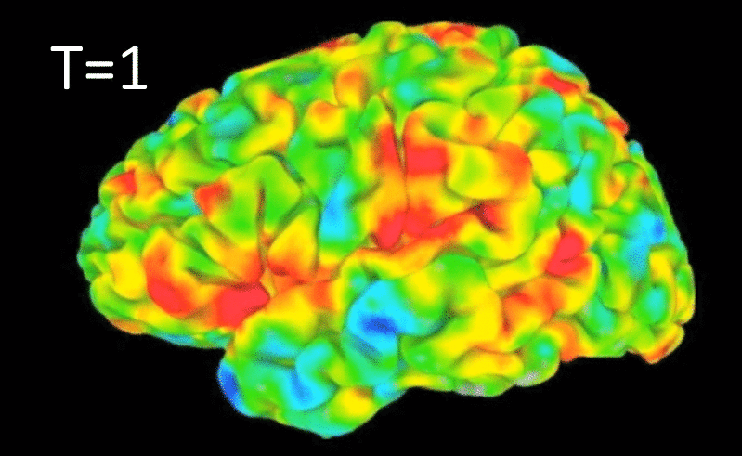
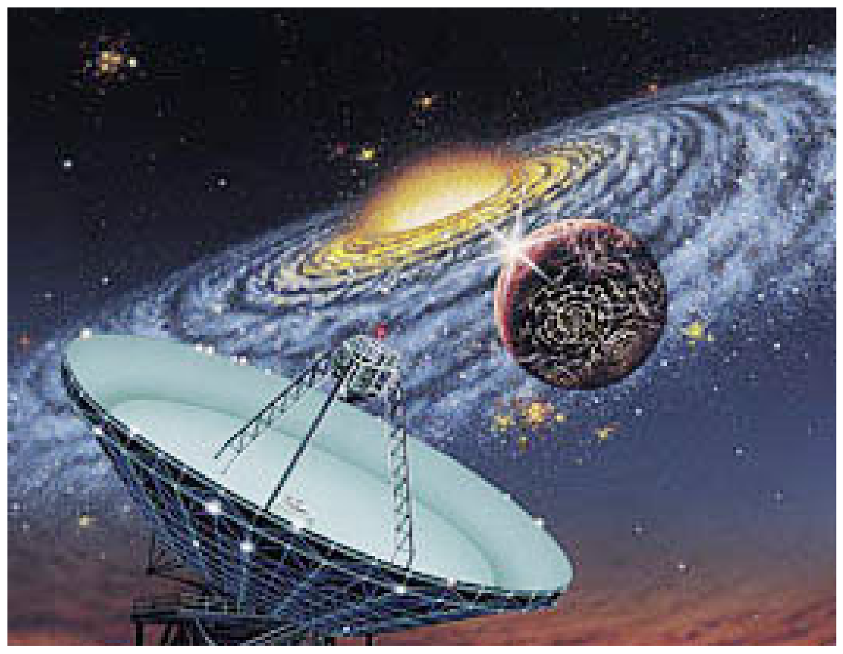
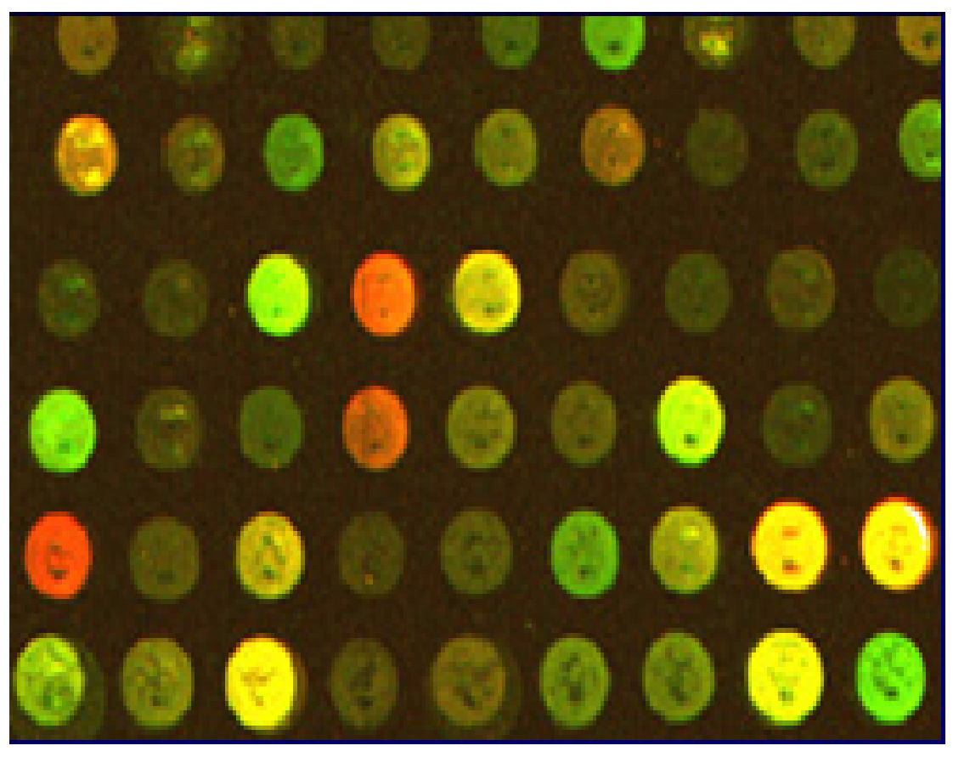
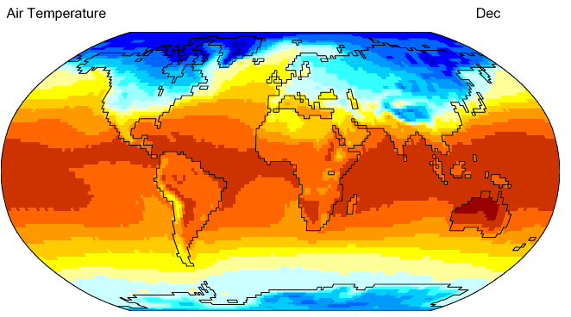
Why Data Mining? Scientific Viewpoint
Data collected and stored at enormous speeds
remote sensors on a satellite
NASA EOSDIS archives over petabytes of earth science data / year
telescopes scanning the skies
Sky survey data
High-throughput biological data
scientific simulations
terabytes of data generated in a few hours
Data mining helps scientists
in automated analysis of massive datasets
formation/validation of hypotheses
fMRI Data from Brain
Sky Survey Data
Gene Expression Data
Surface Temperature of Earth
4
Notes:
4

Slide 5

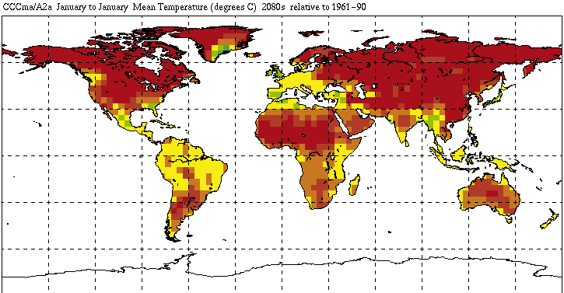


Great Opportunities to Solve Society’s Major Problems
Improving health care and reducing costs
Predicting the impact of climate change
Finding alternative/ green energy sources
Reducing hunger and poverty by
increasing agriculture production
5

Slide 6
What is Data Mining?
Some Definitions
Non-trivial extraction of implicit, previously unknown and potentially useful information from data
Exploration & analysis, by automatic or semi-automatic means, of large quantities of data in order to discover meaningful patterns
6

Slide 7
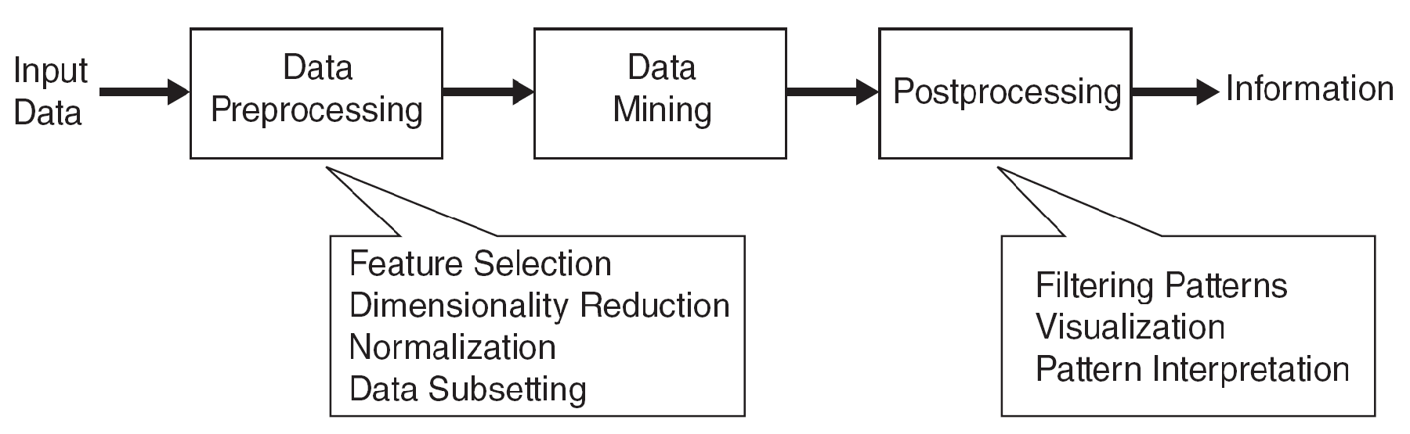
Data Mining Process
7

Slide 8
What is (not) Data Mining?
What is not Data Mining?
Look up phone number in phone directory
Query a Web search engine for information about “Amazon”
What is Data Mining?
Certain names are more prevalent in certain US locations (O’Brien, O’Rourke, O’Reilly… in Boston area)
Group together similar documents returned by a search engine according to their context (e.g., Amazon.com)
8
Notes:
Students names are not considered in DM but their genders segregations may required in DM. Out of 1000 students, DM records of 550 Male, 400 Female & 50 are unknown data of one record is required in DM instead of 1000 records.

Slide 9
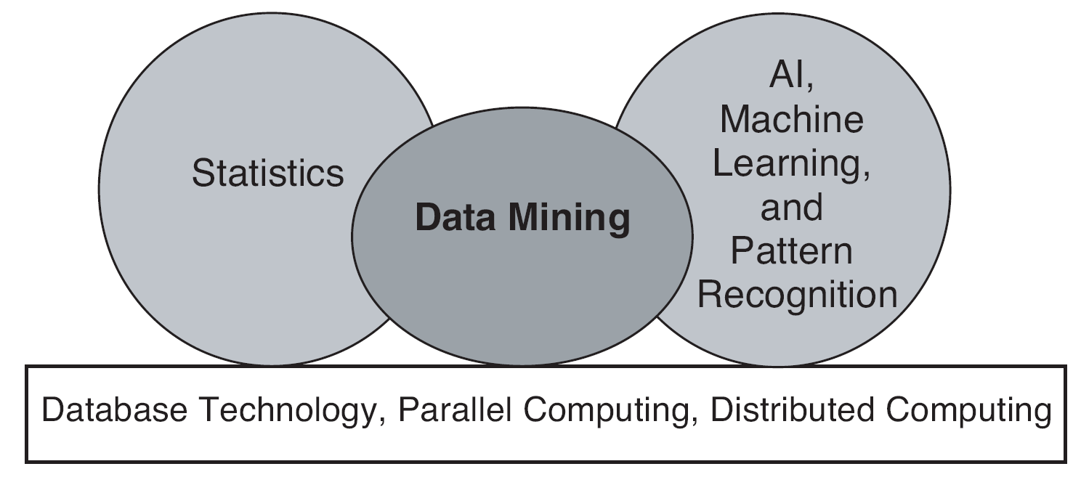
Origins of Data Mining
Draws ideas from machine learning/AI, pattern recognition, statistics, and database systems
Traditional techniques may be unsuitable due to data that is
Large-scale
High dimensional
Heterogeneous
Complex
Distributed
A key component of the emerging field of data science and data-driven discovery
9

Slide 10
Data Mining Tasks
Prediction Methods
Use some variables to predict unknown or future values of other variables.
Description Methods
Find human-interpretable patterns that describe the data.
From [Fayyad, et.al.] Advances in Knowledge Discovery and Data Mining, 1996
10

Slide 11

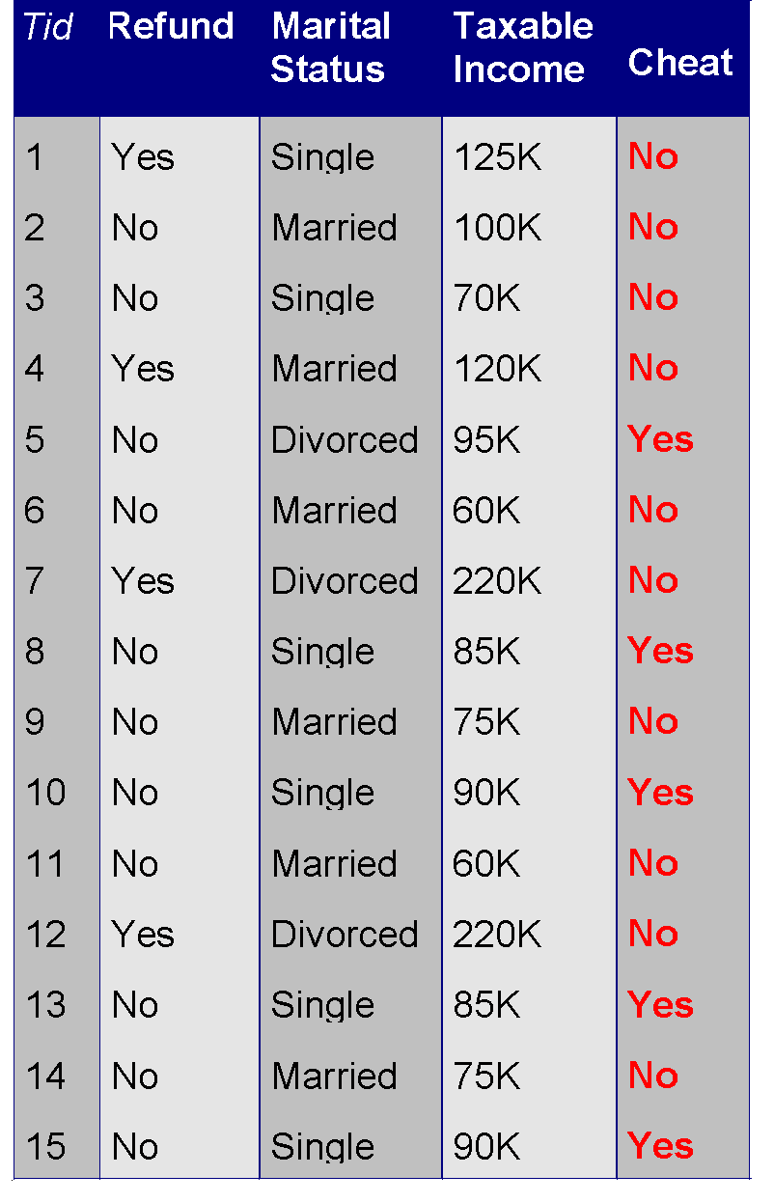
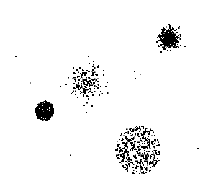


Data Mining Tasks …
Data
Clustering
Predictive Modeling
Association Rules
Anomaly Detection
Milk
11

Slide 12
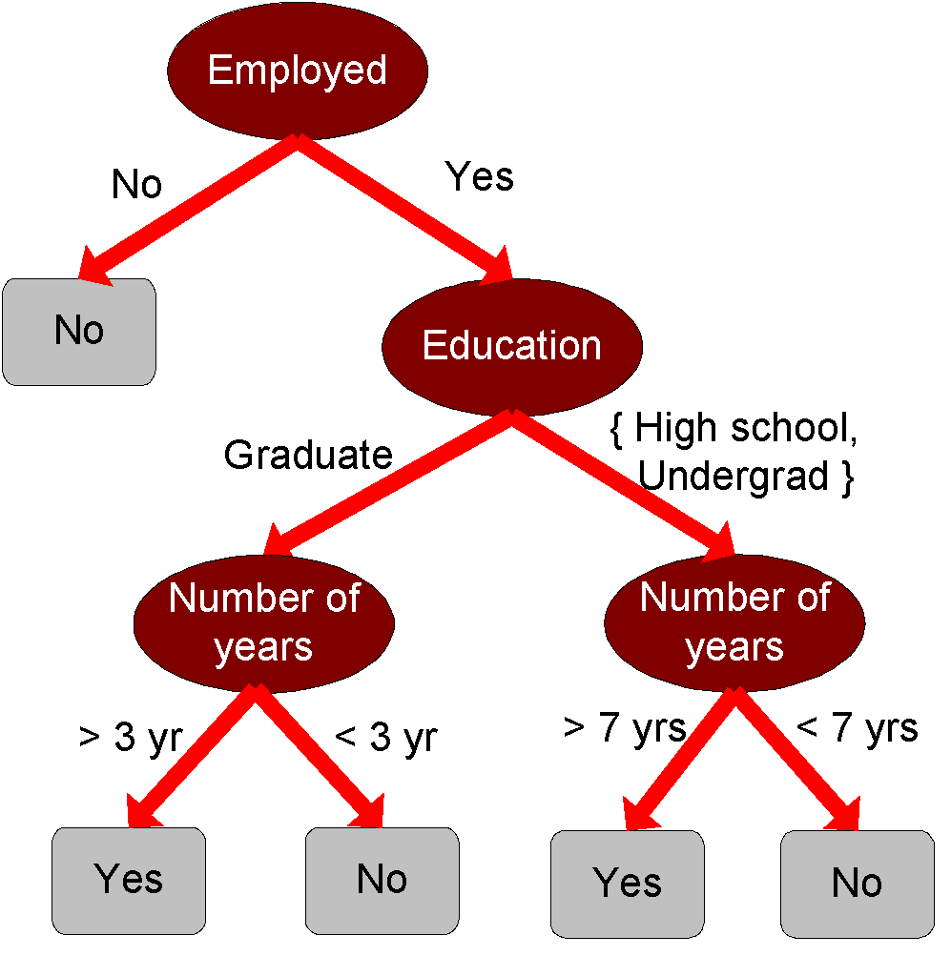
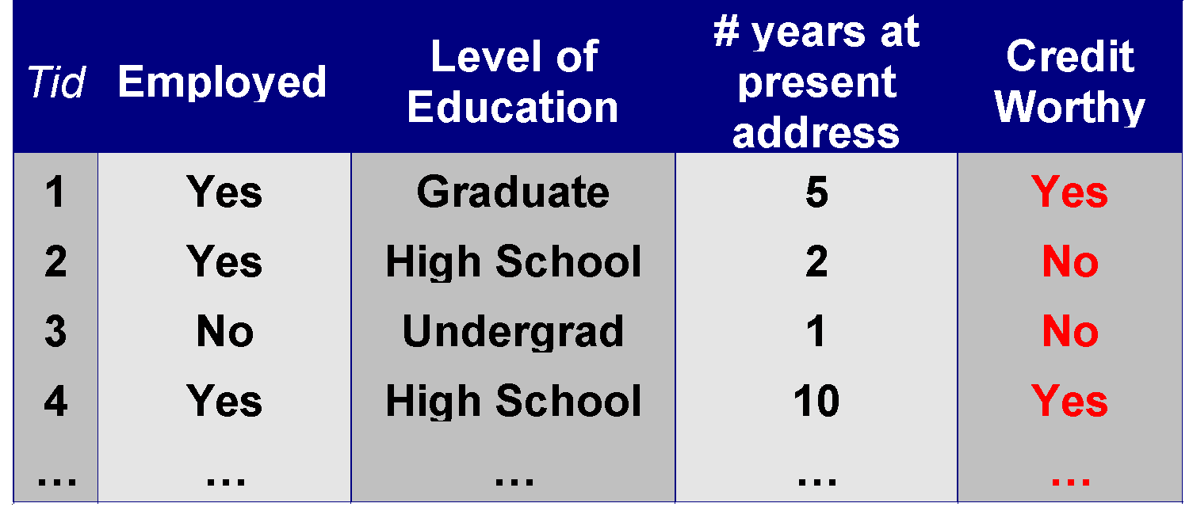
Predictive Modeling: Classification
Find a model for class attribute as a function of the values of other attributes
Model for predicting credit worthiness
Class
12
Notes:
Decision tree is a flowchart-like tree structure, where each node denotes a test on an attributes values, each branch represents an outcome of the test, and tree leaves represent classes or class distributions. Decision tree can be converted to classification rules.

Slide 13
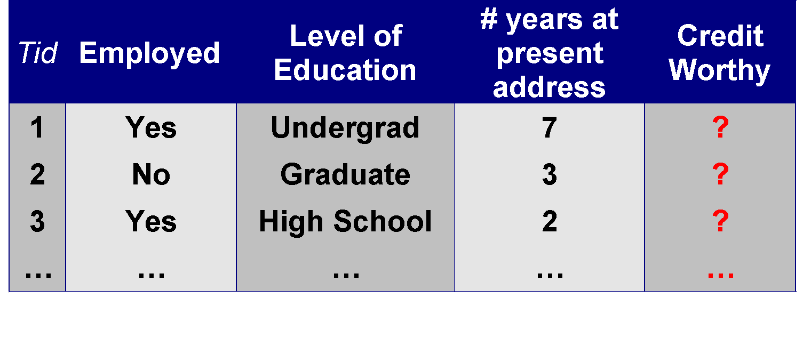
Classification Example
categorical
categorical
quantitative
class
Test Data, Incomplete Future Data
Test
Set
Training Data, Complete Data Historical Data
Learn
Classifier
Training
Set
Model
Predictions
13
Notes:
7 & 3 will be treated as No (Null class)
Model or function
Training Data: Data objects for which the class labels are known. (selected sample data from the past, not all data. Make rules from it to apply on test data)
The Model is used to predict the class label of objects for which the class label is unknown
Classification rules: If-then-else, decision tree, Neural Network
Training data is analyzed by a classification algorithm (classifier/ learned model/ rules)
If an accuracy is acceptable then rules can be applied to the classification of new data records.
Rules will be formulated from Training data. Applying on test data where class “Credit Worthy”, need to be decided using rules

Slide 14
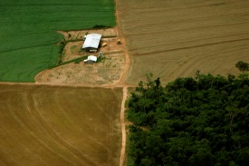
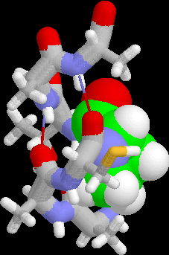
Examples of Classification Task
Classifying credit card transactions as legitimate or fraudulent
Classifying land covers (water bodies, urban areas, forests, etc.) using satellite data
Categorizing news stories as finance, weather, entertainment, sports, etc
Identifying intruders in the cyberspace
Predicting tumor cells as benign or malignant
Classifying secondary structures of protein as alpha-helix, beta-sheet, or random coil
14

Slide 15
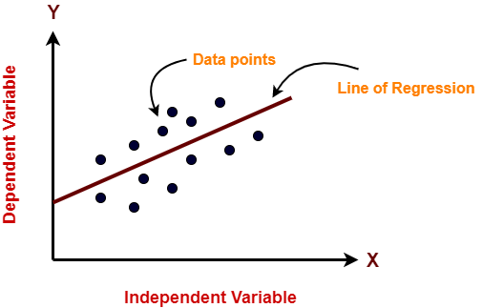
Regression
Predict value of a given continuous valued variable based on the values of other variables, assuming a linear or nonlinear model of dependency.
Examples:
Predicting sales of a new product based on advertising expenditure.
Predicting wind velocity as a function of temperature, humidity, air pressure, etc.
Time series prediction of stock market indices.
15
Notes:
Correlation and Correlation co-effient, Regression, p-value
https://www.youtube.com/watch?v=xTpHD5WLuoA

Slide 16
Clustering
Finding groups of objects such that the objects in a group will be similar (or related) to one another and different from (or unrelated to) the objects in other groups
Inter-cluster distances are maximized
Intra-cluster distances are minimized
16

Slide 17
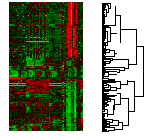
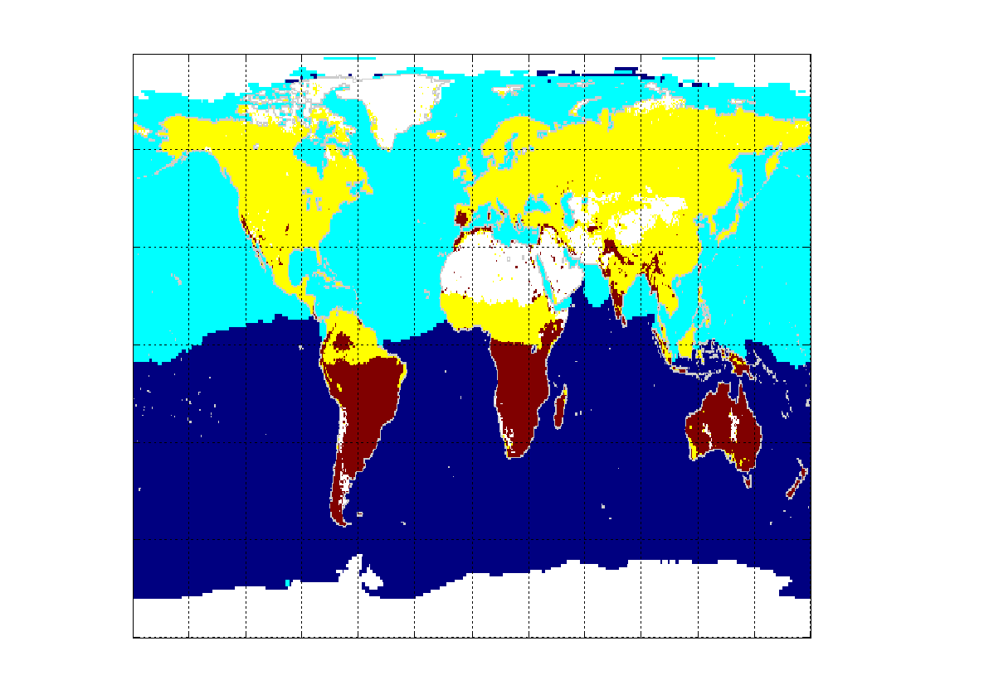
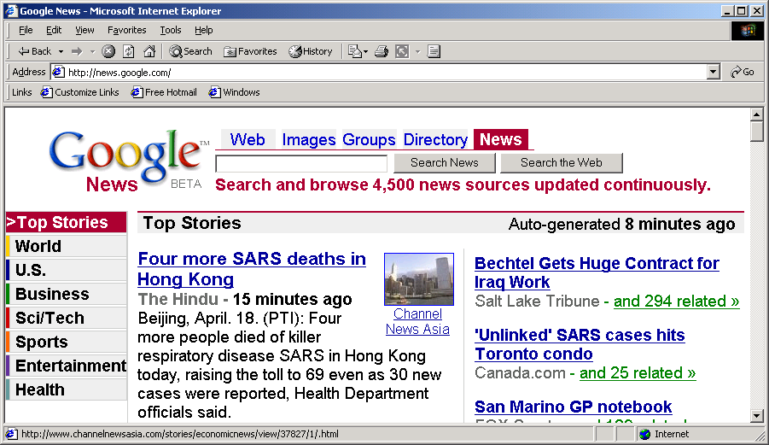
Applications of Cluster Analysis
Understanding
Customer profiling for targeted marketing
Group related documents for browsing
Group genes and proteins that have similar functionality
Group stocks with similar price fluctuations
Summarization
Reduce the size of large data sets
Courtesy: Michael Eisen
Use of K-means to partition Sea Surface Temperature (SST) and Net Primary Production (NPP) into clusters that reflect the Northern and Southern Hemispheres.
17

Slide 18
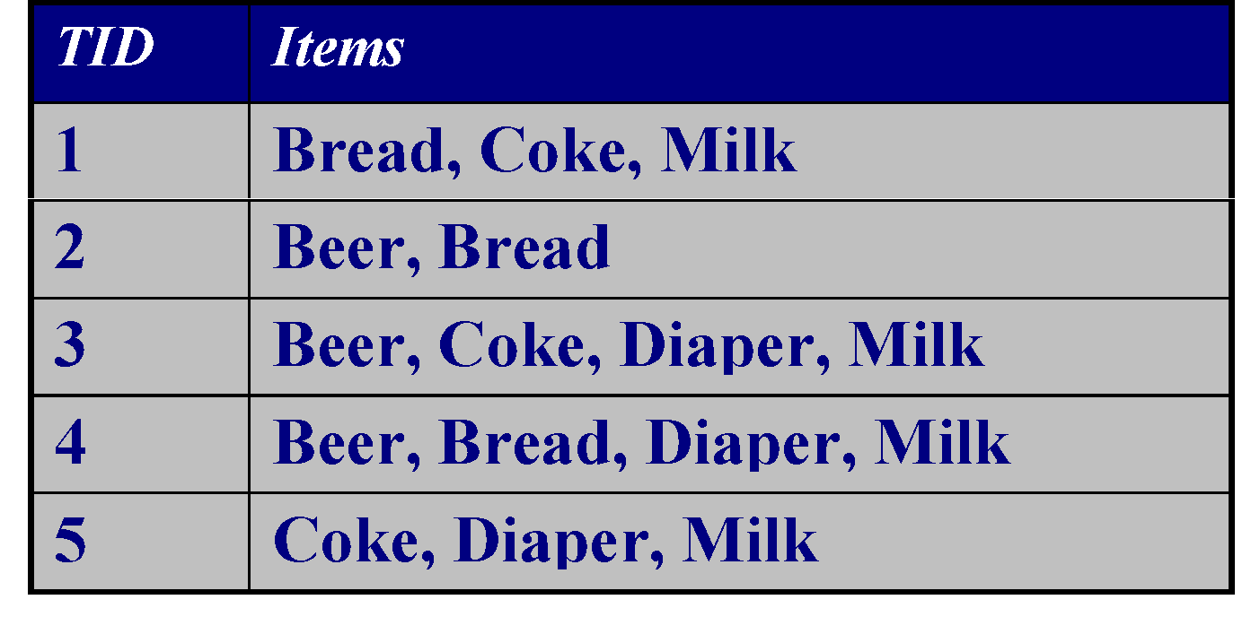
Association Rule Discovery: Definition
Given a set of records each of which contain some number of items from a given collection
Produce dependency rules which will predict occurrence of an item based on occurrences of other items.
Rules Discovered:
{Milk} --> {Coke}
{Diaper, Milk} --> {Beer}
18

Slide 19
Association Analysis: Applications
Market-basket analysis
Rules are used for sales promotion, shelf management, and inventory management
Medical Informatics
Rules are used to find combination of patient symptoms and test results associated with certain diseases
Telecommunication alarm diagnosis
Rules are used to find combination of alarms that occur together frequently in the same time period
19

Slide 20
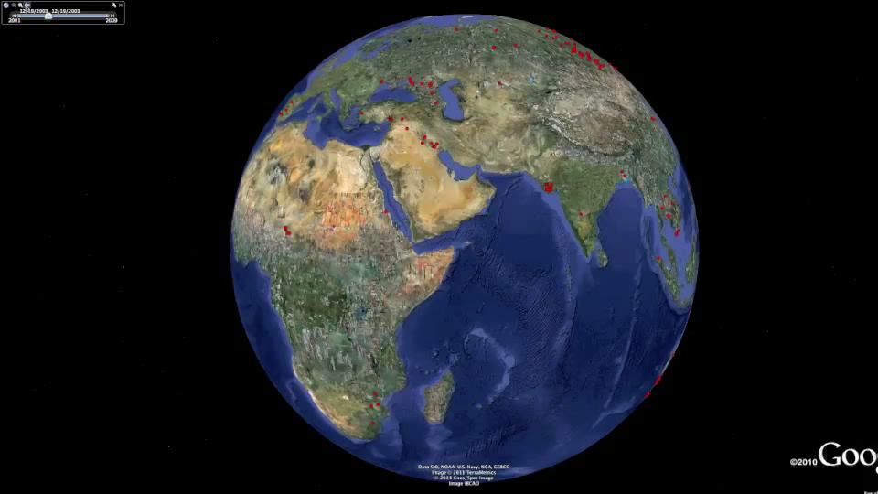
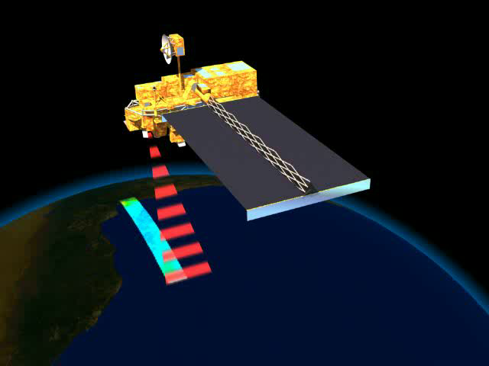
Deviation/Anomaly/Change Detection
Detect significant deviations from normal behavior
Applications:
Credit Card Fraud Detection
Network Intrusion Detection
Identify anomalous behavior from sensor networks for monitoring and surveillance.
Detecting changes in the global forest cover.
20

